Slide 1
Secure data Hiding in Images using steganography
CAPSTONE PROJECT
Presented By
Student Name : Mukul Suyal
College Name & Department : Galgotias University, Financial investment analysis

Slide 2
OUTLINE
Problem Statement
Technology used
Wow factor
End users
Result
Conclusion
Git-hub Link
Future scope

Slide 3
Problem Statement
In today’s digital age, maintaining secure communication presents a considerable challenge. Although encryption effectively protects data by making it unreadable, it can also draw attention to the existence of sensitive exchanges. This project addresses the demand for covert message transmission by employing steganography—a method of hiding information within seemingly innocuous images. The proposed solution features a user-friendly GUI application that effortlessly integrates text messages into digital images for discreet communication.

Slide 4
Technology used
Libraries & Platforms
Libraries:
OpenCV (cv2)
Tkinter & ttk
NumPy
Pillow
Pathlib
Platform:
Python 3.8+

Slide 5
Wow factors
Modern Dark-Themed GUI - Professional interface with real-time status updates and color-coordinated design, making steganography accessible to non-technical users.
Dual Input System - Supports both direct text input and file loading, with automatic message length validation and image capacity checking.
Enhanced Security - Password protection for encoding/decoding with robust error handling, while maintaining original image quality.
Smart Message Processing - Efficient pixel utilization and automatic message length preservation, preventing data overflow while ensuring message integrity. These features combine security with user-friendliness, setting it apart from typical steganography tools that sacrifice one for the other.

Slide 6
End users
Privacy-Conscious Individuals
Educational Sector
Security Professionals
Digital Rights Activists
Government institutions

Slide 7
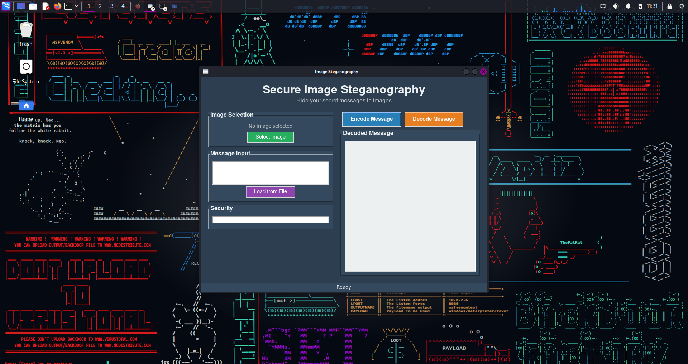
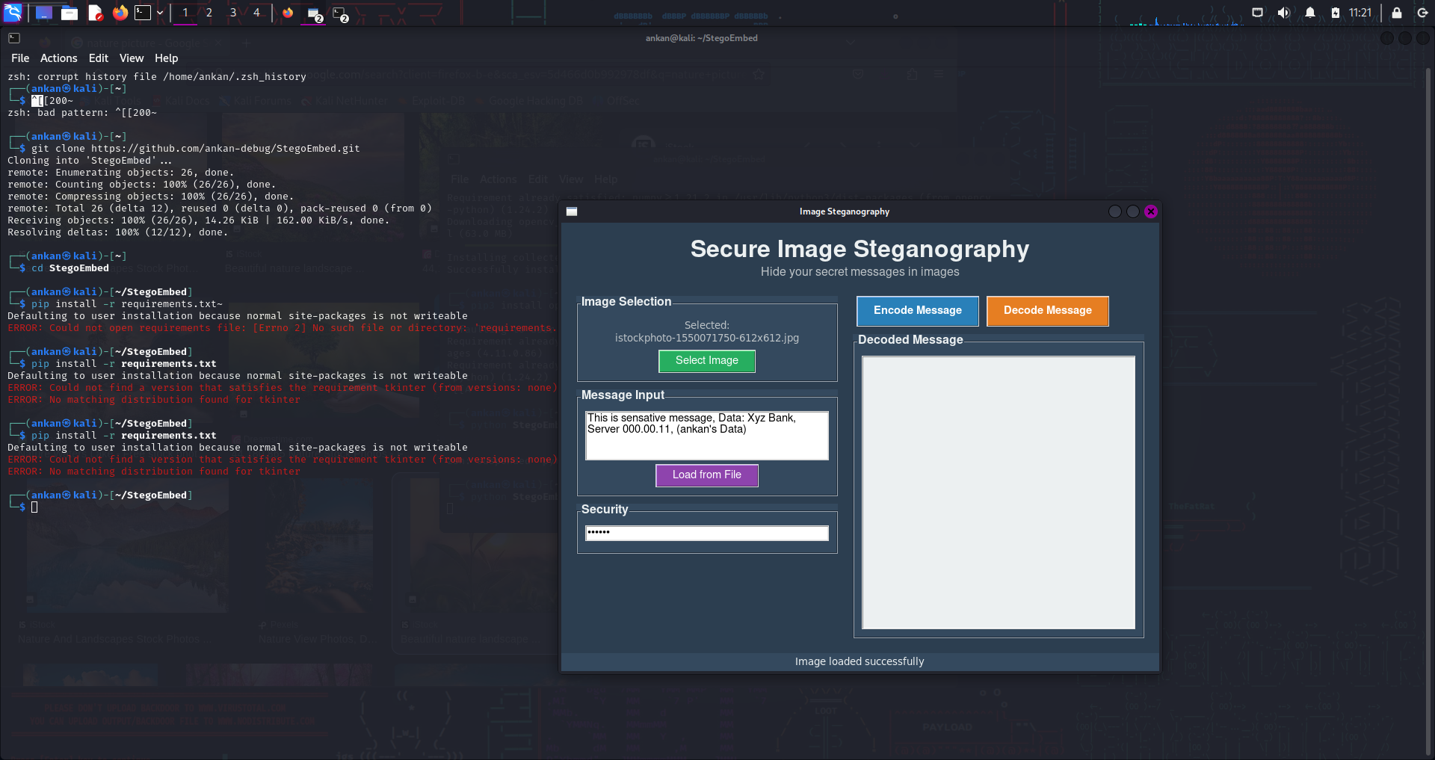
Results
This is sensitive message, Data: Xyz Bank, Server 000.00.11, (Mukul’s Data)
Output after running command
Encoding data in the image

Slide 8
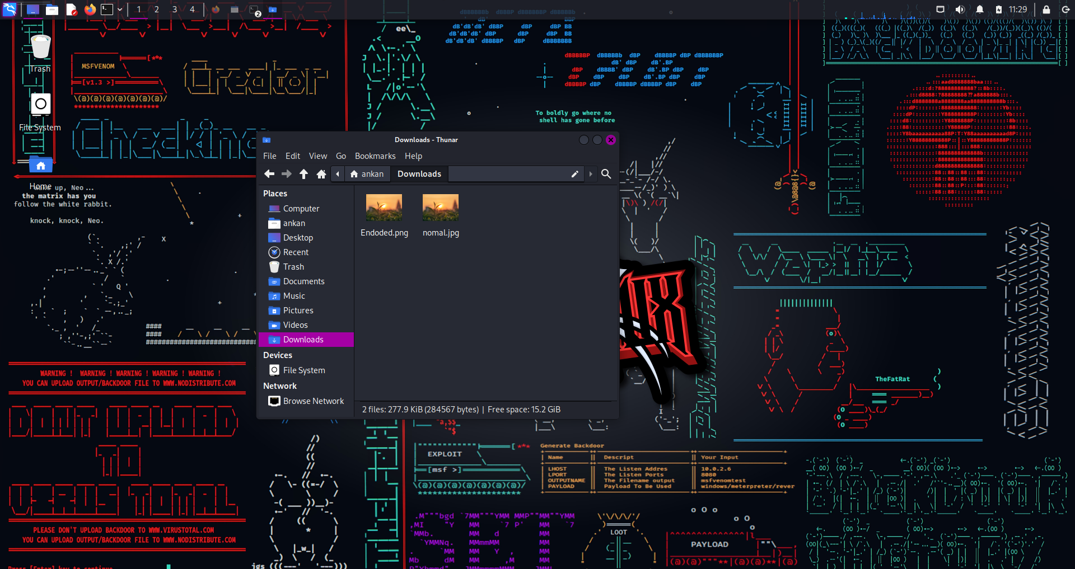
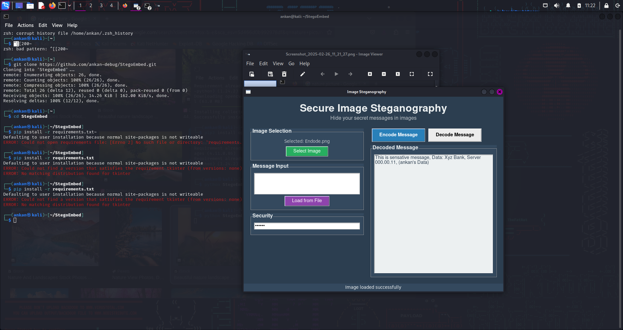
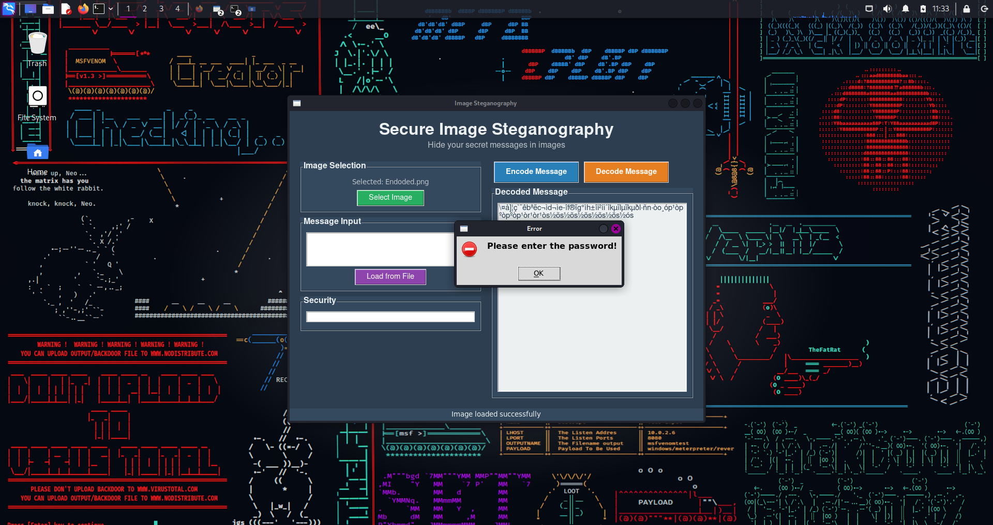
Results
🏠 mukul
Downloads
This is sensative message, Data: Xyz Bank, Server 000.00.11, (mukul’s Data)
Normal & encoded pic
Wrong or No Password Error
Final Output If Password is correct

Slide 9
Conclusion
This Image Steganography application effectively fulfills the demand for covert communication by offering a secure and user-friendly method to embed messages within digital images. The project accomplishes its primary goals through the following features:
•Enhanced Security and Privacy: It employs LSB steganography combined with password protection, ensuring that hidden messages remain invisible to casual observers.
•User Accessibility: The application features an intuitive, dark-themed interface, making steganography approachable for both technical and non-technical users.
•Dependable Performance: By incorporating automatic capacity checks and optimizing pixel usage, it safeguards message integrity, preventing data corruption or loss.
By balancing security with ease of use, this project makes secure communication accessible to privacy-conscious users, educators, and security professionals alike.

Slide 10
GitHub Link
https://github.com/Mukulll0000/Mukul-debug-StegoEmbed.git

Slide 11
Future scope
Enhanced Security : Implementation of advanced encryption algorithms (AES/RSA) alongside steganography, and support for hiding messages in audio/video files.
Advanced Features : Integration of blockchain for message verification, cloud storage support for secure image sharing, and AI-powered steganography detection resistance.
Cross-Platform Development : Mobile application development (Android/iOS) and web-based version with real-time collaboration features.

Slide 12
THANK YOU

